Slide 1
Safely Placing and Removing Cloth Face Masks
Irving Independent School District
Clinic and Health Services

Slide 2
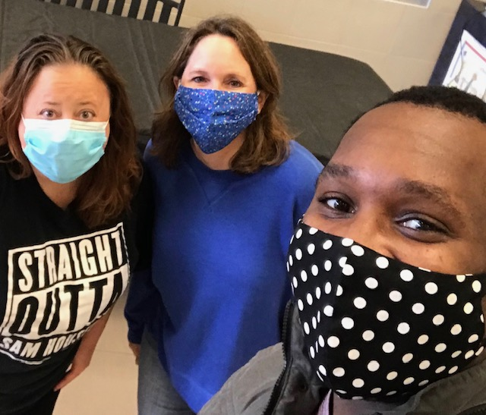
The CDC recommends wearing cloth face masks in public settings where you are unable to maintain the proper physical distancing of 6 feet—common areas, cafeteria, some classrooms.
They advise that the cloth coverings may help slow the spread of the COVID-19 virus by preventing people who may have the virus and are unaware or without symptoms, from spreading it to others.
They DO NOT recommend surgical or N-95 respirator masks to be worn by the general public.
If you can’t be 6 feet apart:
Wear Your Mask!

Slide 3
Scroll across screen for video
Wearing and Caring For Your Mask

Slide 4
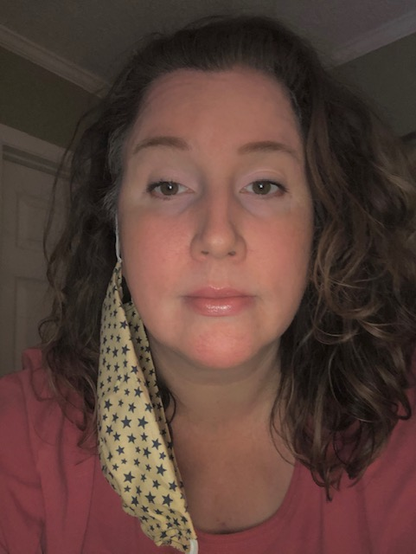
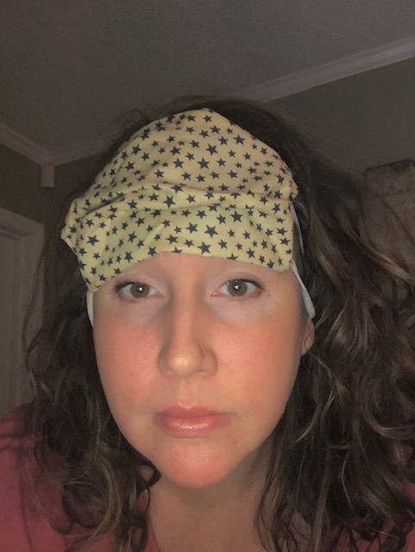
WRONG ways to wear your mask:

Slide 5
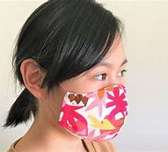
Your mask should:
Fit your face snuggly but comfortably
Cover nose and mouth at all times but not be so large that it touches the eyes
Should not be touched once it is properly in place
Be made of a material that is able to be laundered and dried without damage to the shape
Be washed daily and whenever soiled or becomes moist
Correct

Slide 6
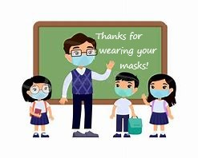

Slide 7
References
https://www.ohiohealth.com/
https://www.health.nd.gov/sites/www/files/documents/Files/MSS/coronavirus/PPEwithN95andPAPRchecklistforAirbornePrecaution.pdf
https://www.infectioncontroltoday.com/personal-protective-equipment/ppe-donning-and-doffing-reveals-gaps-knowledge-and-practice
https://www.ajicjournal.org/article/S0196-6553(18)30680-1/fulltext
https://www.cdc.gov/

Slide 8
Special Thank You
Janice Houston
(Houston Middle School Digital Learning Coach)
For filming and editing assistance
Nancy Atkinson
(Houston Middle School Assistant Principal)
For Appearing in video clip

